Slide 1
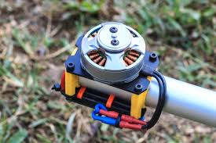
First Course of Special Machine
Department of Electrical Power and Machine Engineering
By Qasim Al Azze 2018

Slide 2
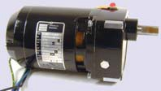
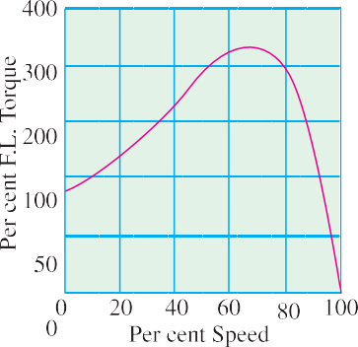
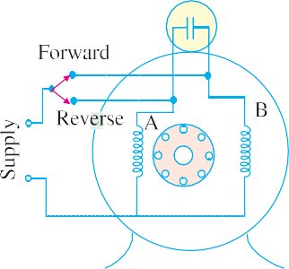
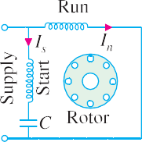
Single-phase Motors
1381
36.8. Capacitor Start-and-Run Motor
This motor is similar to the capacitor-start motor [Art.36.4 (ii)] except that the starting winding
and capacitor are connected in the circuit at all times. The advantages of leaving the capacitor permanently in circuit are (i) improvement of over-load capacity of the motor (ii) a higher power factor (iii) higher efficiency and (iv) quieter running of the motor which is so much desirable for small power drives in offices and laboratories. Some of these motors which start and run with one value of capacitance in the circuit are called single-value capacitor-run motors. Other which start with high value of capacitance but run with a low value of
Capacitor starts and run motor
capacitance are known as two-value capacitor-run motors.
(i) Single-value capacitor-Run Motor
It has one running winding and one starting winding in series with a capacitor as shown in Fig.
36.28. Since capacitor remains in the circuit permanently, this motor is often referred to as permanent-
Fig. 36.28 Fig. 36.29 Fig. 36.30
split capacitor-run motor and behaves practically like an unbalanced 2-phase motor. Obviously, there is no need to use a centrifugal switch which was necessary in the case of capacitor-start motors. Since the same capacitor is used for starting and running, it is obvious that neither optimum starting nor optimum running performance can be obtained because value of capacitance used must be a compro- mise between the best value for starting and that for running. Generally, capacitors of 2 to 20 μF capacitance are employed and are more expensive oil or pyranol-insulated foil-paper capacitors be- cause of continuous-duty rating. The low value of the capacitor results in small starting torque which is about 50 to 100 per cent of the rated torque (Fig. 36.29). Consequently, these motors are used where the required starting torque is low such as air - moving equipment i.e. fans, blowers and voltage regulators and also oil burners where quiet operation is particularly desirable.
One unique feature of this type of motor is that it can be easily reversed by an external switch provided its running and starting windings are identical. One serves as the running winding and the other as a starting winding for one direction of rotation. For reverse rotation, the one that previously served as a running winding becomes the starting winding while the former starting winding serves as the running winding. As seen from Fig. 36.30 when the switch is in the forward position, winding B serves as running winding and A as starting winding. When switch is in ‘reverse’ position, winding A becomes the running winding and B the starting winding.

Slide 3
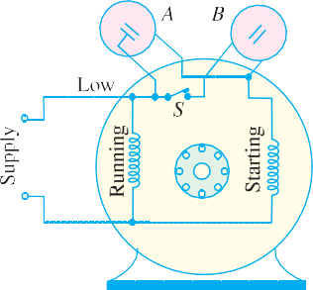
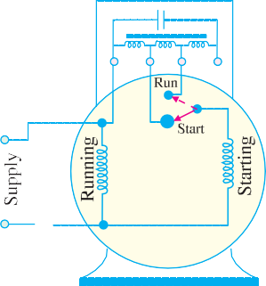
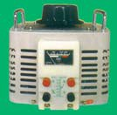
1382
Electrical Technology
Such reversible motors are often used for operating devices that must be moved back and forth very frequently such as rheostats, induction regulations, furnace controls, valves and arc-welding controls.
(ii) Two-value capacitor-Run Motor
This motor starts with a high capacitor in series with the starting winding so that the starting torque is high. For running, a lower capacitor is substituted by the centrifugal switch. Both the running and starting windings remain in circuit.
The two values of capacitance can be obtained as follows:
by using two capacitors in parallel at the start and then switching out one for low-value run. (Fig. 36.31) or
by using a step-up auto-transformer in conjunction with one capacitor so that effective capacitance value is increased for starting purposes.
In Fig. 36.31, B is an electrolytic capacitor of high capacity (short duty) and A is an oil capacitor of low value (continuous duty). Generally, starting capacitor B is 10 to 15 times the running capacitor A . At the start, when the centrifugal switch is closed, the two capacitors are put in parallel, so that their combined capacitance is the sum of their individual
Fig. 36.31 Fig.36.32
capacitances. After the motor has reached 75 per cent full-load speed, the switch opens and only capacitor A remains in the starting winding circuit. In this
way, both optimum starting and running performance is achieved in such motors. If properly designed, such motors have operating characteristics very closely resembling those displayed by two-phase motors. Their performance is characterised by
ability to start heavy loads
extremely quiet operation
higher efficiency and power factor
ability to develop 25 per cent overload capacity
Hence, such motors are ideally suited where load require- ments are severe as in the case of compressors and fire strokers etc.
Auto-transformer
The use of an auto-transformer and single oil-type capacitor is illustrated in Fig.36.32. The transformer and capacitor are sealed in a rectangular iron box and mounted on top of the motor. The idea behind using this combination is that a capacitor of value C connected to the secondary of a step- up transformer, appears to the primary as though it had a value of K²C where K is voltage transforma- tion ratio. For example, if actual value of C = 4 μF and K = 6, then low-voltage primary acts as if it had a 144 μF ( = 6² × 4) capacitor connected across its terminals. Obviously, effective value of capacitance has increased 36 times. In the ‘start’ position of the switch, the connection is made to the

Slide 4
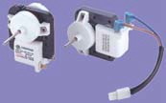
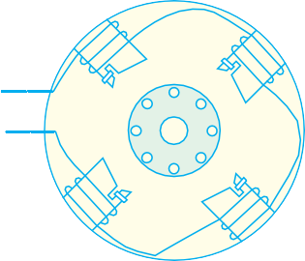
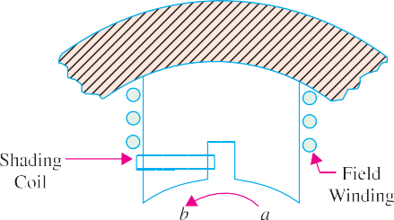
Single-phase Motors
1383
mid-tap of the auto-transformer so that K = 2. Hence, effective value of capacitance at start is 4 times the running value and is sufficient to give a high starting torque. As the motor speeds up, the centrifu- gal switch shifts the capacitor from one voltage tap to another so that the voltage transformation ratio changes from higher value at starting to a lower value for running. The capacitor which is actually of the paper-tinfoil construction is immersed in a high grade insulation like wax or mineral oil.
36.9. Shaded-pole Single- phase Motor
In such motors, the necessary phase-splitting is produced by induction. These motors have salient poles on the stator and a squirrel-cage type rotor Fig.
36.33 shows a four-pole motor with the field poles connected in series for alternate polarity. One pole of such a motor is shown separately in Fig. 36.34. The laminated pole has a slot cut across the laminations approximately one-third distance from one edge. Around the small part of the pole is placed a short- circuited Cu coil known as shading coil. This part of the pole is known as shaded part and the other as
Shaded pole single phase motor
unshaded part. When an alternating current is passed through the exciting (or field) winding surrounding the whole pole, the axis of the pole shifts from the unshaded part a to the shaded part b. This shifting of the magnetic axis is, in effect, equivalent to the actual physical movement of the pole. Hence, the rotor starts rotating in the direction of this shift i.e. from unshaded part to the shaded part.
Fig. 36.33 Fig. 36.34
Let us now discuss why shifting of the magnetic axis takes place. It is helpful to remember that the shading coil is highly inductive. When the alternating current through exciting coil tends to increase, it induces a current in the shading coil by transformer action in such a direction as to oppose its growth. Hence, flux density decreases in the shaded part when exciting current increases. However, flux density increases in the shaded part when exciting current starts decreasing (it being assumed that exciting current is sinusoidal).
In Fig. 36.35 (a) exciting current is rapidly increasing along OA (shown by dots). This will
produce an e.m.f. in the shading coil. As shading coil is of low resistance, a large current will be set up in such a direction (according to Lenz’s law) as to oppose the rise of exciting current (which is responsible for its production). Hence, the flux mostly shifts to the unshaded part and the magnetic axis lies along the middle of this part i.e. along NC.
Next, consider the moment when exciting current is near its peak value i.e. from point A to B [Fig. 36.35 (b)]. Here, the change in exciting current is very slow. Hence, practically no voltage and, therefore, no current is induced in the shading coil. The flux produced by exciting current is at its maximum value and is uniformly distributed over the pole face. So the magnetic axis shifts to the centre of the pole i.e. along positions ND.

Slide 5
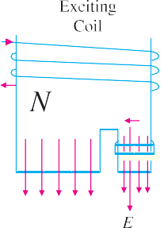
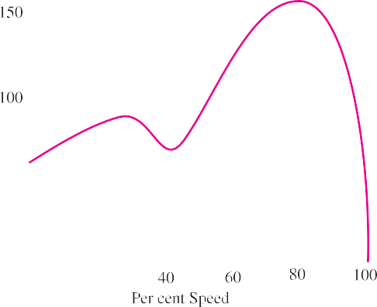
1384
Electrical Technology
Fig. 36.35 (c) represents the condition when the exciting current is rapidly decreasing from B to
C. This again sets up induced current in the shading coil by transformer action. This current will flow in such a direction as to oppose this decrease in exciting current, with the result that the flux is strengthened in the shaded part of the pole. Consequently, the magnetic axis shifts to the middle part of the shaded pole i.e. along NE.
Fig. 36.35
From the above discussion we find that during the positive half-cycle of the exciting current, a N-pole shifts along the pole from the unshaded to the shaded part. During the next negative half- cycle of the exciting current, a S-pole trails along. The effect is as if a number of real poles were actually sweeping across the space from left to right.
Shaded pole motors are built
commercially in very small sizes, varying approximately from 1/250 h.p. (3W) to 1/6 h.p. (125 W).
Although such motors are simple in construction, extremely rugged, reliable and cheap, they suffer from the disadvantages of (i) low starting torque (ii) very little overload capacity and (iii) low efficiency. Efficiencies vary from 5% (for tiny sizes) to 35 (for higher ratings). Because of its low starting torque, the shaded-pole motor is generally used for small fans, toys, instruments, hair dryers, ventilators, circulators and electric clocks. It is also frequently used for such devices as churns, phonograph turntables and advertising displays etc. The
Fig. 36.36
direction of rotation of this motor cannot be changed, because it is fixed by the position of copper rings.
A typical torque / speed curve for such a motor is shown in Fig. 36.36.

Slide 6
First Course of Special Machine
Department of Electrical Power and Machine Engineering
By Qasim Al Azze 2018

Slide 7
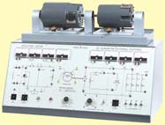
Single-phase Motors
1385
36.10. Repulsion Type Motors
These can be divided into the following four distinct categories :
Repulsion Motor. It consists of (a) one stator winding (b) one rotor which is wound like a d.c. armature (c) commu- tator and (d) a set of brushes, which are short-circuited and remain in contact with the commutator at all times. It operates continuously on the ‘repulsion’ principle. No short-circuiting mechanism is re- quired for this type.
Compensated Repulsion Motor. It is identical with repulsion motor in all re-
Repulsion induction motor
spects, except that (a) it carries an additional stator winding, called compensating winding
(b) there is another set of two brushes which are placed midway between the usual short- circuited brush set. The compensating winding and this added set are connected in series.
Repulsion-start Induction-run Motor. This motor starts as a repulsion motor, but nor- mally runs as an induction motor, with constant speed characteristics. It consists of (a) one stator winding (b) one rotor which is similar to the wire-wound d.c. armature (c) a commu- tator and (d) a centrifugal mechanism which short-circuits the commutator bars all the way round (with the help of a short-circuiting necklace) when the motor has reached nearly 75 per cent of full speed.
Repulsion Induction Motor. It works on the combined principle of repulsion and induc-
tion. It consists of (a) stator winding (b) two rotor windings : one squirrel cage and the other usual d.c. winding connected to the commutator and (c) a short-circuited set of two brushes.
It may be noted that repulsion motors have excellent characterstics, but are expensive and require more attention and maintenance than single-phase motors. Hence, they are being replaced by two- value capacitor motors for nearly all applications.
36.11. Repulsion Motor
Constructionally, it consists of the following :
Stator winding of the distributed non-salient pole type housed in the slots of a smooth-cored stator (just as in the case of split-phase motors). The stator is generally wound for four, six or eight poles.
A rotor (slotted core type) carrying a distributed winding (either lap or wave) which is connected to the commutator. The rotor is identical in construction to the d.c. armature.
A commutator, which may be one of the two types : an axial commutator with bars parallel
to the shaft or a radial or vertical commutator having radial bars on which brushes press horizontally.
Carbon brushes (fitted in brush holders) which ride against the commutator and are used for conducting current through the armature (i.e. rotor) winding.
36.12. Repulsion Principle
To understand how torque is developed by the repulsion principle, consider Fig. 36.37 which shows a 2-pole salient pole motor with the magnetic axis vertical. For easy understanding, the stator winding has been shown with concentrated salient-pole construction (actually it is of distributed non- salient type). The basic functioning of the machine will be the same with either type of construction. As mentioned before, the armature is of standard d.c. construction with commutator and brushes (which are short-circuited with a low-resistance jumper).

Slide 8
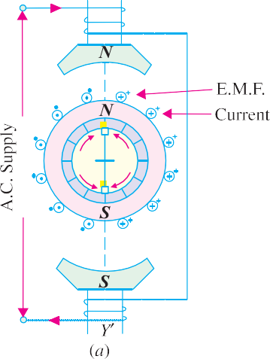
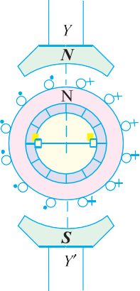
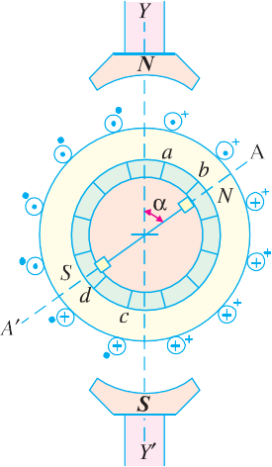
1386
Electrical Technology
Suppose that the direction of flow of the alternating current in the exciting or field (stator) winding is such that it creates a N-pole at the top and a S-pole at the bottom. The alternating flux produced by the stator winding will induce e.m.f. in the armature conductors by transformer action. The direction of the induced e.m.f. can be found by using Lenz’s law and is as shown in Fig. 36.37 (a). However, the direction of the induced currents in the armature conductors will depend on the positions of the
short-circuited brushes. If brush axis is colinear with magnetic axis of the main poles, the directions of the induced currents (shown by dots and arrows) will be as indicated in Fig. 36.37 (a)*. As a result, the armature will become an electromagnet with a N-pole on its top, directly under the main N-pole and with a S-pole at the bottom, directly over the main S-pole. Because of this face-to- face positioning of the main and induced magnetic poles, no torque will be developed. The two forces of repulsion on top and bottom act along Y Y′ in direct opposition to each other.**
If brushes are shifted through 90º to the position shown in Fig. 36.37 (b) so that the brush axis is at right angles to
Fig. 36.37
the magnetic axis of the main poles, the directions of the induced voltages at any time in the respective
armature conductors are exactly the same as they were for the brush position of Fig.
36.37 (a). However, with brush positions of Fig. 36.37 (b), the voltages induced in the armature conductors in each path between the brush terminals will neutralize each other, hence there will be no net voltage across brushes to produce armature current. If there is no armature current, obviously, no torque will be developed.
If the brushes are set in position shown in Fig. 36.38 (a) so that the brush axis is neither in line with nor 90º from the mag- netic axis Y Y′ of the main poles, a net volt- age*** will be induced between the brush terminals which will produce armature cur- rent. The armature will again act as an elec-
*
Fig. 36.38
It should be noted that during the next half-cycle of the supply current, the directions of the respective
voltages will be in the opposite directions.
** Alternatively, the absence of the torque may be explained by arguing that the torques developed in the four quadrants neutralize each other.
*** It will be seen from Fig. 36.38 (a) that the induced voltages in conductors a and b oppose the voltages in other conductors lying above brush-axis. Similarly, induced voltages in conductors c and d oppose the voltages in other conductors, lying below the brush-axis. Yet the net voltage across brush terminals will be sufficient to produce current which will make the armature a powerful magnet.

Slide 9


Single-phase Motors
1387
tromagnet and develop its own N-and S-poles which, in this case, will not directly face the respective main poles. As shown in Fig. 36.38 (a), the armature poles lie along A A′ making an angle of α with Y Y′.
Hence, rotor N-pole will be repelled by the main N-pole and the rotor S-pole will, similarly, be repelled by the main S-pole. Consequently, the rotor will rotate in clockwise direction [Fig.36.38
(b)]. Since the forces are those of repulsion, it is appropriate to call the motor as repulsion motor.
It should be noted that if the brushes are shifted counter-clockwise from YY ′, rotation will also be counter-clockwise. Obviously, direction of rotation of the motor is determined by the position of brushes with respect to the main magnetic axis.
It is worth noting that the value of starting torque developed by such a motor will depends on the amount of brush-shift whereas direction of
Repulsion motor
rotation will depend on the direction of shift [Fig. 36.39 (a)]. Maximum starting torque is developed at some position where brush axis makes, an angle lying between 0º and 45º with the magnetic axis of main poles. Motor speed can also be controlled by means of brush shift. Variation of starting torque of a repulsion motor with brush-shift is shown in Fig. 36.39 (b).
A straight repulsion type motor has high starting torque (about 350 per cent) and moderate starting current (about 3 to 4 times full-load value).
Principal shortcomings of such a motor are :
speed varies with changing load, becoming dangerously high at no load.
low power factor, except at high speeds.
tendency to spark at brushes.
36.13. Compensated Repulsion Motor
It is a modified form of the straight repulsion motor discussed above. It has an additional stator winding, called compensating winding whose purpose is (i) to improve power-factor and (ii) to pro- vide better speed regulation. This winding is much smaller than the stator winding and is usually wound in the inner slots of each main pole and is connected in series with the armature (Fig. 36.40) through an additional set of brushes placed mid-way between the usual short-circuited brushes.
Fig. 36. 39 Fig. 36. 40
36.14. Repulsion-start Induction-Run Motor
As mentioned earlier, this motor starts as an ordinary repulsion motor, but after it reaches about 75 per cent of its full speed, centrifugal short-circuiting device short-circuits its commutator. From

Slide 10
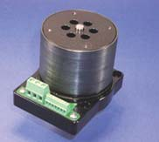
1388
Electrical Technology
then on, it runs as an induction motor, with a short-circuited squirrel-cage rotor. After the commutator is short-circuited, brushes do not carry any current, hence they may also be lifted from the commutator, in order to avoid unnecessary wear and tear and friction losses.
Repulsion-start motors are of two different designs :
Brush-lifting type in which the brushes are automatically lifted from the commutator when it is short-circuited. These motors generally employ radial form of commutator and are built both in small and large sizes.
Brush-riding type in which brushes ride on the commutator at all times. These motors use axial form of commutator and are always built in small sizes.
The starting torque of such a motor is in excess of 350 per cent with moderate starting current. It is particularly useful where starting period is of comparatively long duration, because of high inertia loads. Applications of such motors include machine tools, commercial refrigerators, compressors, pumps, hoists, floor-polishing and grinding devices etc.
36.15. Repulsion Induction Motor
In the field of repulsion motor, this type is becoming very popular, because of its good all-round characteristics which are comparable to those of a compound d.c. motor. It is particularly suitable for those applications where the load can be removed entirely by de-clutching or by a loose pulley.
This motor is a combination of the repulsion and induction types and is sometimes referred to as squirrel-cage repulsion motor. It possesses the desirable characteristics of a repulsion motor and the constant-speed characteristics of an induction motor.
It has the usual stator winding as in all repulsion motors. But there are two separate and indepen- dent windings in the rotor (Fig. 36.41).
a squirrel-cage winding and
commutated winding similar to that of a d.c. armature.
Both these windings function during the entire period of operation of the motor. The commu- tated winding lies in the outer slots while squirrel-cage winding is located in the inner slots*. At start,
the commutated winding supplies most of the torque, the squirrel-cage winding being practically inactive because of its high reactance. When the rotor accelerates, the squirrel-cage winding takes up a larger portion of the load.
The brushes are short-circuited and ride on the commutator continuously. One of the advantages of this motor is that it requires no centrifugal short- circuiting mechanism. Sometimes such motors are also made with compensating winding for improv- ing the power factor.
As shown in Fig. 36.42, its starting torque is high, being in excess of 300 per cent. Moreover, it has a fairly constant speed regulation. Its field of application includes house-hold refrigerators, garage air pumps, petrol pumps, compressors,
Brushless d.c. seromotor
machine tools, mixing machines, lifts and hoists etc.
* Hence, commutated winding has low resistance whereas the squirrel-cage winding has inherently a high reactance.

